Slide 1
Reinforcement Learning
Session 2
openAI gym
.
( Disclaimer: content has been taken from various authors and websites)
Notes:
3/1/2019
1

Slide 2
Todays Agenda
Reinforcement Learning ( overview)
openAI gym
Questions.

Slide 3
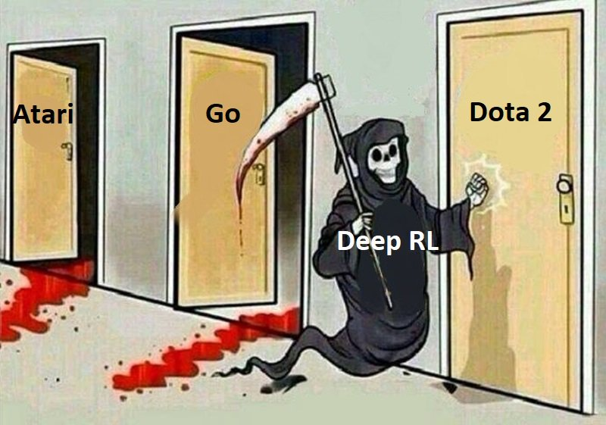

Slide 4
What is RL ?
Reinforcement learning is where an agent must take actions in an environment in order to maximize some defined reward function
In the learning process, the agent actively interacts with its environment over several iterations, it eventually begins to learn the policy describing which actions to take to maximize the reward.
Trial and Error Approach to Learning
Delayed Reward

Slide 5

Components of RL ?
Environment: Physical world in which the agent operates
State: Current situation of the agent
Reward: Feedback from the environment. It’s a real NUMBER
Policy: Method to map agent’s state to actions
Value: Future reward that an agent would receive by taking an action in a particular state

Slide 6
Reinforcement Learning Steps
The process of Reinforcement Learning involves these simple steps:
Observation of the environment
Deciding how to act using some strategy
Acting accordingly
Receiving a reward or penalty
Learning from the experiences and refining our strategy
Iterate until an optimal strategy is found

Slide 7
OpenAI Gym
https://gym.openai.com/
OpenAI Gym is a toolkit for developing and comparing reinforcement learning algorithms.
It supports teaching agents everything from walking to playing games like pong or pinball.
Gym is an open source interface to reinforcement learning tasks.
Gym provides an environment and its is upto the developer to implement any reinforcement learning algorithms

Slide 8
OpenAI Gym Install on Anaconda running on Ubuntu 18
This instructions are for my setup, yours may be different,
Please note I have already installed Cuda 9.0and cuDNN and Anaconda and python 3
Open Terminal
Sudo apt update
conda update conda
conda update –all
Anaconda-terminal
When anaconda starts,
2) Create a new Environment under Python 3.6, ( I named the virtual env as openai)
Open the environment, and
pip install gym
pip install –upgrade tensorflow-gpu ( for CPU pip install –upgrade tensorflow)
Sudo pip3 install pandas matplotlib pillow scipy seaborn scikit-learn scikit-image h5py
Sudo apt-get install python3-pip python3-dev

Slide 9
Test gym install
#test_gym_install
import gym
from gym import envs
print(envs.registry.all())
# this should print out all the environments available in gym.

Slide 10
Basic Gym Concepts
We have
Environment (namely, the outside world)
Agent (namely, the algorithm you are writing).
The agent sends actions to the environment, and the environment replies with observations and rewards (that is, a numeric score).
How do we create the Environment

Slide 11
Environment env
This is the Main Class.
Creates an world/environment with random dynamics.
env = gym.make(‘environmentname’)
Main API Methods
step Run one timestep of the environment's dynamics.
reset Resets the state of the environment and returns an initial observation
render Renders the environment
close closes the environment
seed Sets the seed for this env's random number generator(s)
Sets the following attributes
action_space: The Space object corresponding to valid actions
observation_space: The Space object corresponding to valid observations
reward_range: A tuple corresponding to the min and max possible rewards

Slide 12
env.step()
observation = env.step(action)
Run one timestep of the environment's dynamics.
Accepts an action and returns a tuple (observation, reward, done, info).
Args:
action (object): an action provided by the environment
Returns (tuple):
observation (object): agent's observation of the current environment
reward (float) : amount of reward returned after previous action
done (boolean): episode has reached terminal step.
info (dict): additional environment specific information about the current state induced by the action.

Slide 13
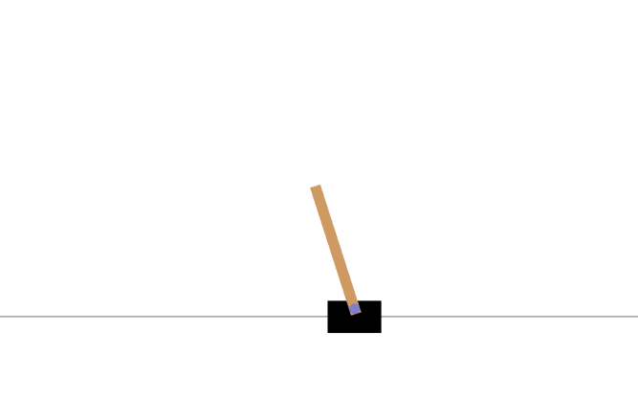
CartPole-v0
A pole is attached by an un-actuated joint to a cart, which moves along a frictionless track.
The pendulum starts upright, and the goal is to prevent it from falling over by increasing and reducing the cart's velocity.

Slide 14
CartPole-v0 (contd)
Observations
Type: Box(4)
Actions:
Type: Discrete(2)
Num | Observation | Min | Max
0 | Cart Position | -4.8 | 4.8
1 | Cart Velocity | -Inf | inf
2 | Pole Angle | -24deg | 24deg
3 | Pole Velocity at tip | -inf | inf
Num | Action
0 | Push cart to the left
1 | Push cart to the right

Slide 15
CartPole Game Rules
Episode Termination:
Pole Angle is more than 12 degrees
Cart Position is more than 2.4 (center of the cart reaches the edge of the display)
Episode length is greater than 200
Solved Requirements:
When the average reward is greater than or equal to 195.0 over 100 consecutive trials

Slide 16
Jupyter Notebooks
test_gym_install
Cartpole
Cartpole_structured
Cartpole_structured_randomwalk
Cartpole_structured_hillclimb
Cartpole_structured_hillclimb

Slide 17
Next Session
Q Tables
DQN

Slide 18
Contact Details
Email: aliasgertalib@gmail.com
Linkedin: https://www.linkedin.com/in/aliasgertalib
GitHub
https://github.com/aliasgertalib-AI

Slide 19
References
OpenAI Gym
RL Terminology

Slide 20
Difficulties with RL
You can quantify all the variables the environment describes and have access to these variables at each time step, or state.
You can define a concrete reward function and compute the reward for taking an action.
You can afford to make mistakes.

Slide 21
Inverse Reinforcement Learning
IRL: Attempts to extract the reward function from the observed behavior of an agent.
In a real world environment, the biggest challenges in getting AI systems to do what we want is specifying what we want.
In RL, a well fitting reward function is necessary to provide feedback about an agents behavior.
In many real life scenarios it is quite difficult finding a good reward function to be used.
Inverse reinforcement learning (IRL) is an approach to automatically learn a reward function based on observations of how some (human) expert solved a task

Slide 22
Comparison of reinforcement learning algorithms
Algorithm | Description | Model | Policy | Action Space | State Space | Operator
Monte Carlo | Every visit to Monte Carlo | Model-Free | Off-policy | Discrete | Discrete | Sample-means
Q-learning | State–action–reward–state | Model-Free | Off-policy | Discrete | Discrete | Q-value
SARSA | State–action–reward–state–action | Model-Free | On-policy | Discrete | Discrete | Q-value
Q-learning - Lambda | State–action–reward–state with eligibility traces | Model-Free | Off-policy | Discrete | Discrete | Q-value
SARSA - Lambda | State–action–reward–state–action with eligibility traces | Model-Free | On-policy | Discrete | Discrete | Q-value
DQN | Deep Q Network | Model-Free | Off-policy | Discrete | Continuous | Q-value
DDPG | Deep Deterministic Policy Gradient | Model-Free | Off-policy | Continuous | Continuous | Q-value
A3C | Asynchronous Advantage Actor-Critic Algorithm | Model-Free | Off-policy | Continuous | Continuous | Q-value
NAF | Q-Learning with Normalized Advantage Functions | Model-Free | Off-policy | Continuous | Continuous | Advantage
TRPO | Trust Region Policy Optimization | Model-Free | On-policy | Continuous | Continuous | Advantage
PPO | Proximal Policy Optimization | Model-Free | On-policy | Continuous | Continuous | Advantage

